Slide 1




NEXT GEN EMPLOYABILITY PROGRAM
Creating a future-ready workforce
Team Members
College Name
Student Name :K.AtchayaBarathi
Student ID : au960221104037
Arunachala College of Engineering for women

Slide 2

CAPSTONE PROJECT SHOWCASE
Project Title
Car Rentals Application with Django Framework
Abstract | Problem Statement | Project Overview | Proposed Solution | Technology Used | Modelling & Results | Conclusion

Slide 3
Abstract
DriveEase offers a user-friendly app for seamless car rentals. Browse vehicles, select flexible options, and book with ease. Enjoy convenient pickup, optional extras, and 24/7 support. Travel hassle-free with DriveEase.
Source :

Slide 4
Problem Statement
Many travelers face inconvenience and inefficiency when trying to rent a car due to complicated booking processes, limited vehicle options, and lack of support for unexpected issues, leading to frustration and delays in their travel plans.
Source :

Slide 5
Project Overview
The DriveEase Car Rental App simplifies vehicle rental with a user-friendly interface, diverse vehicle selection, and flexible booking options. It ensures convenience through a seamless booking process, secure transactions, and 24/7 customer support, revolutionizing the car rental experience for travelers.
Source :

Slide 6
Proposed Solution
.
DriveEase offers a streamlined solution for car rentals. Our user-friendly app provides a diverse vehicle selection, flexible booking options, and seamless transactions. With 24/7 support, we ensure a hassle-free experience for travelers, redefining the way people rent cars.
Source :

Slide 7
User-Friendly Interface: Intuitive design for easy navigation and booking.
Diverse Vehicle Selection: Wide range of vehicles to cater to different preferences and needs.
Flexible Booking Options: Choose rental durations and packages according to individual requirements.
Seamless Transactions: Secure payment process for peace of mind.
24/7 Customer Support: Assistance available round-the-clock for any queries or concerns.
Source :

Slide 8
Convenience: Convenient pickup and drop-off locations for a hassle-free experience.
Reliability: Ensuring reliable service to meet the expectations of travelers.
Enhanced Experience: Optional extras available to enhance the journey.
Efficiency: Streamlined process for quick and efficient bookings.
Innovation: Utilizing technology to revolutionize the car rental experience.
Source :

Slide 9


Technology Used
Front-end
Back-end
Source :

Slide 10
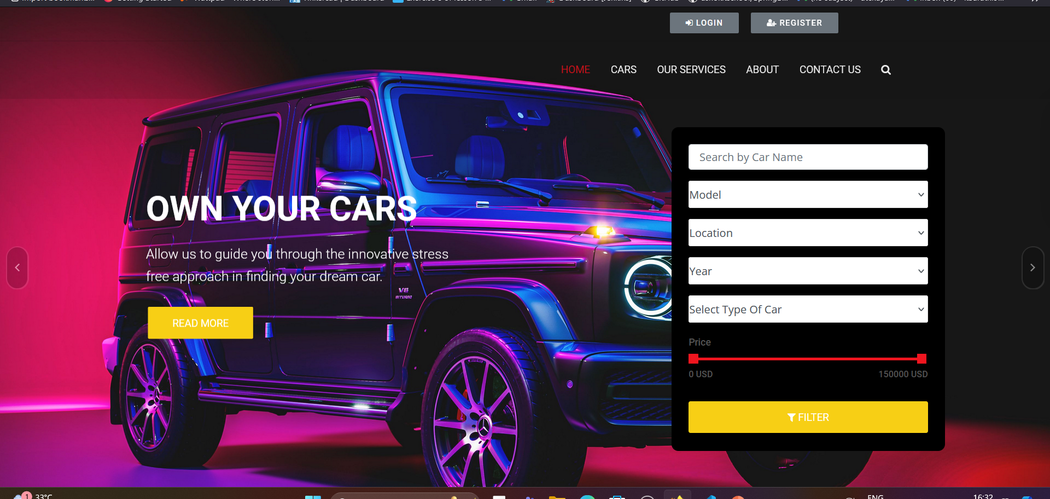
Modelling & Results
Source :

Slide 11
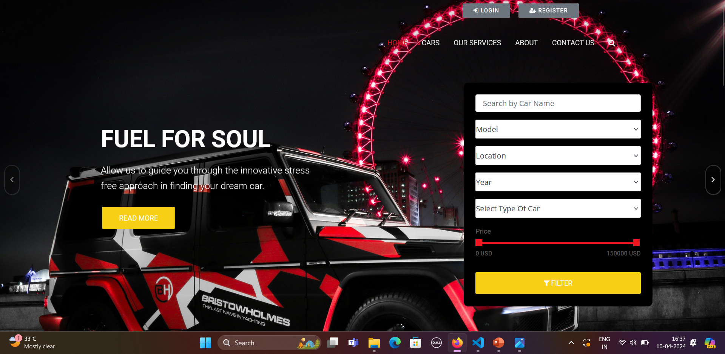
Homepage

Slide 12
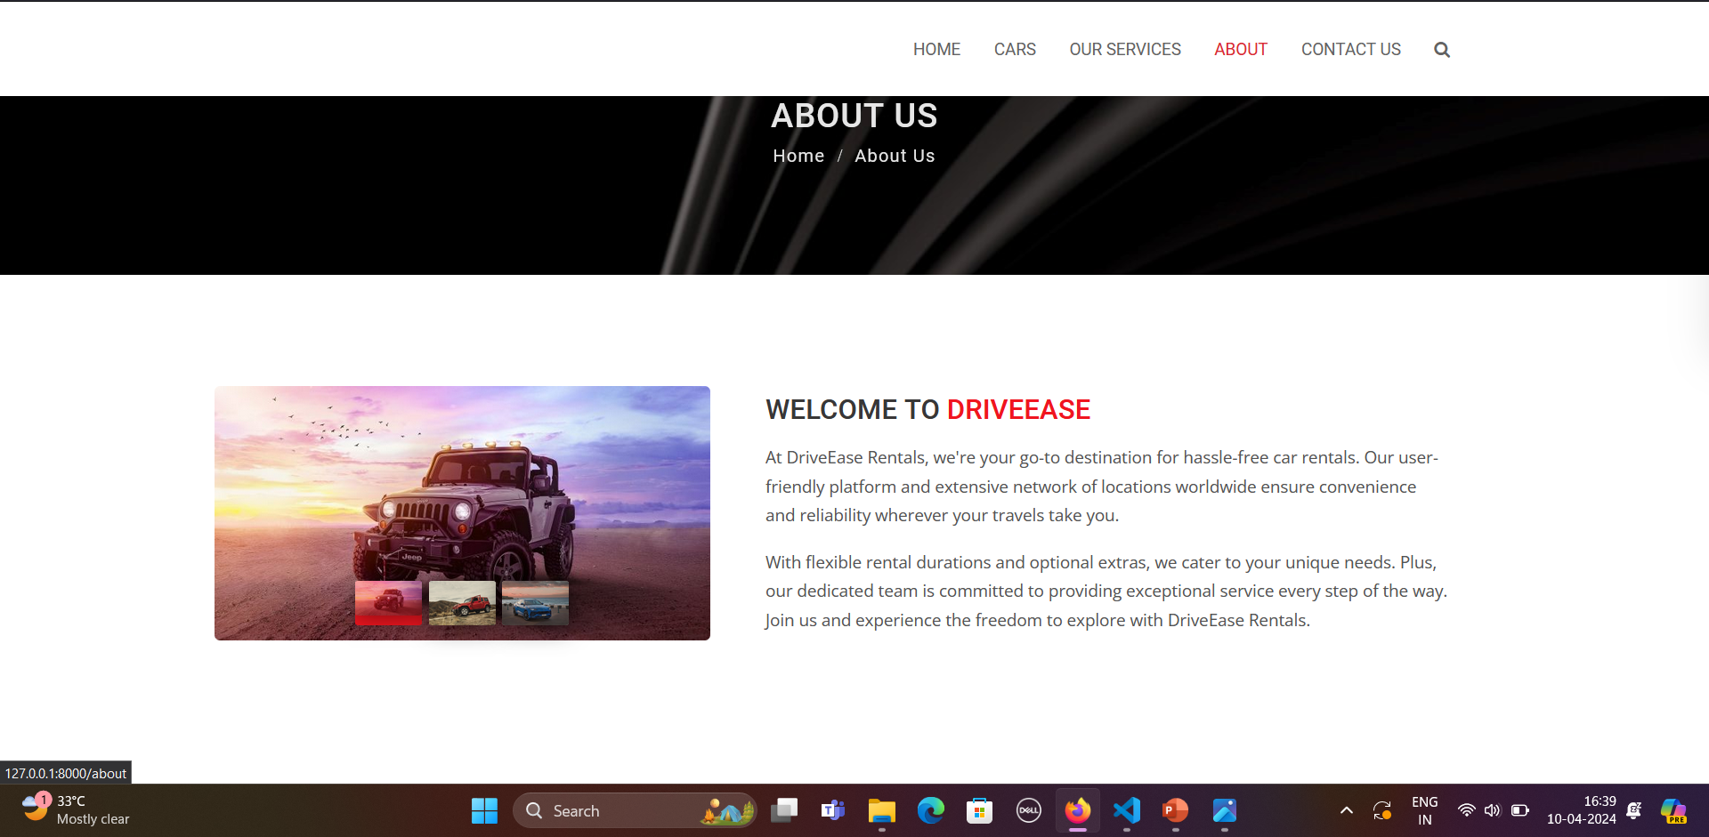
About-Us-Page

Slide 13
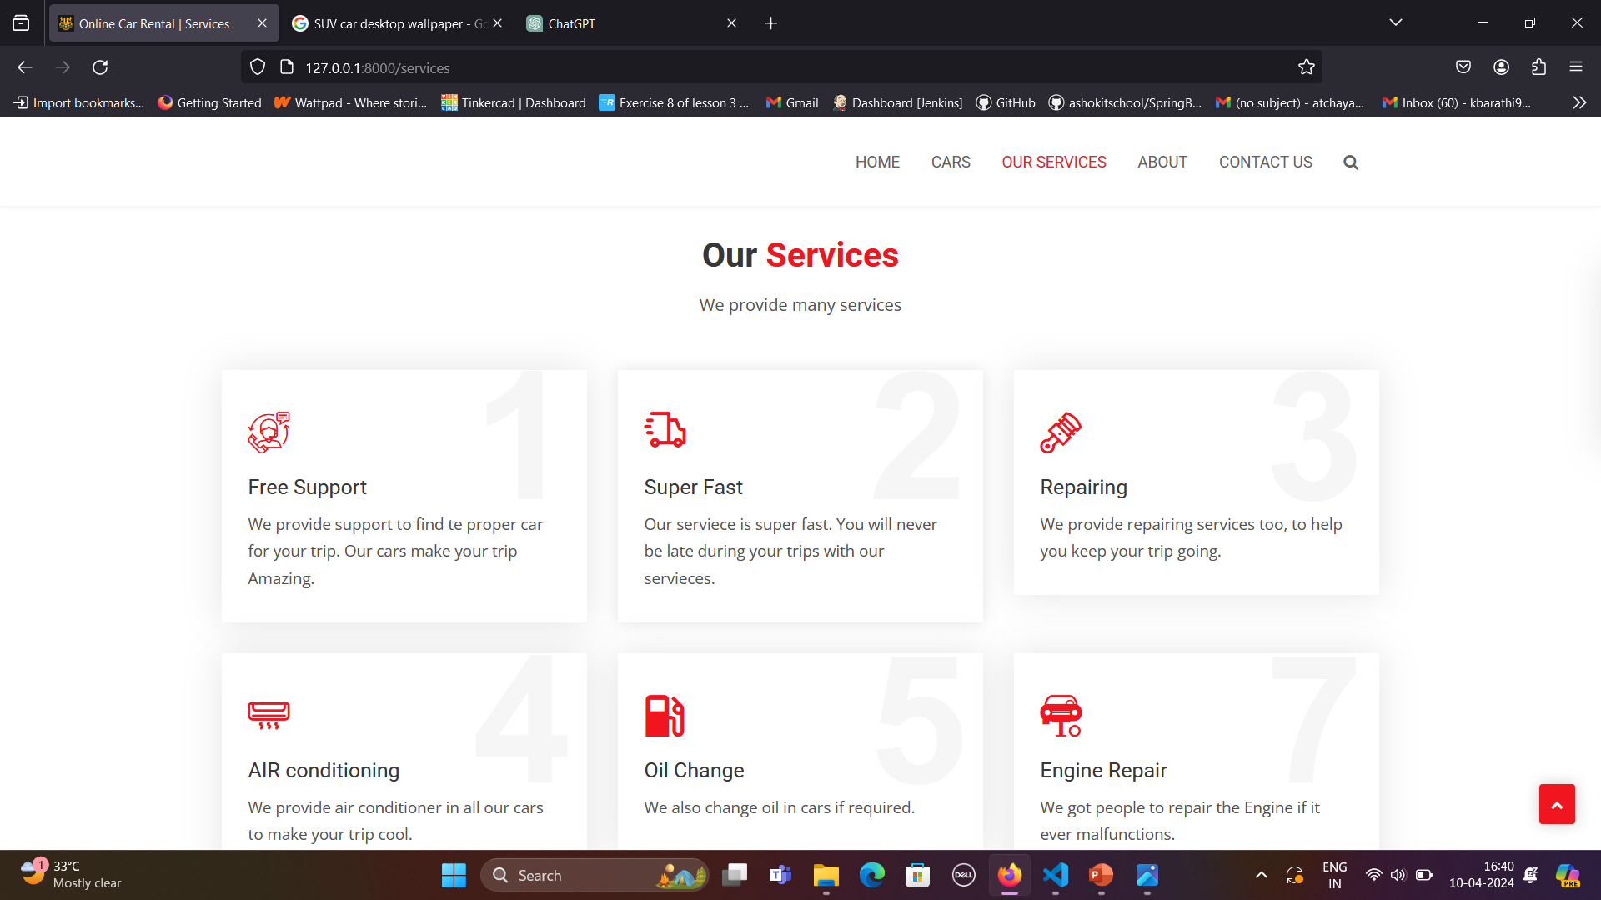
Service-Page

Slide 14
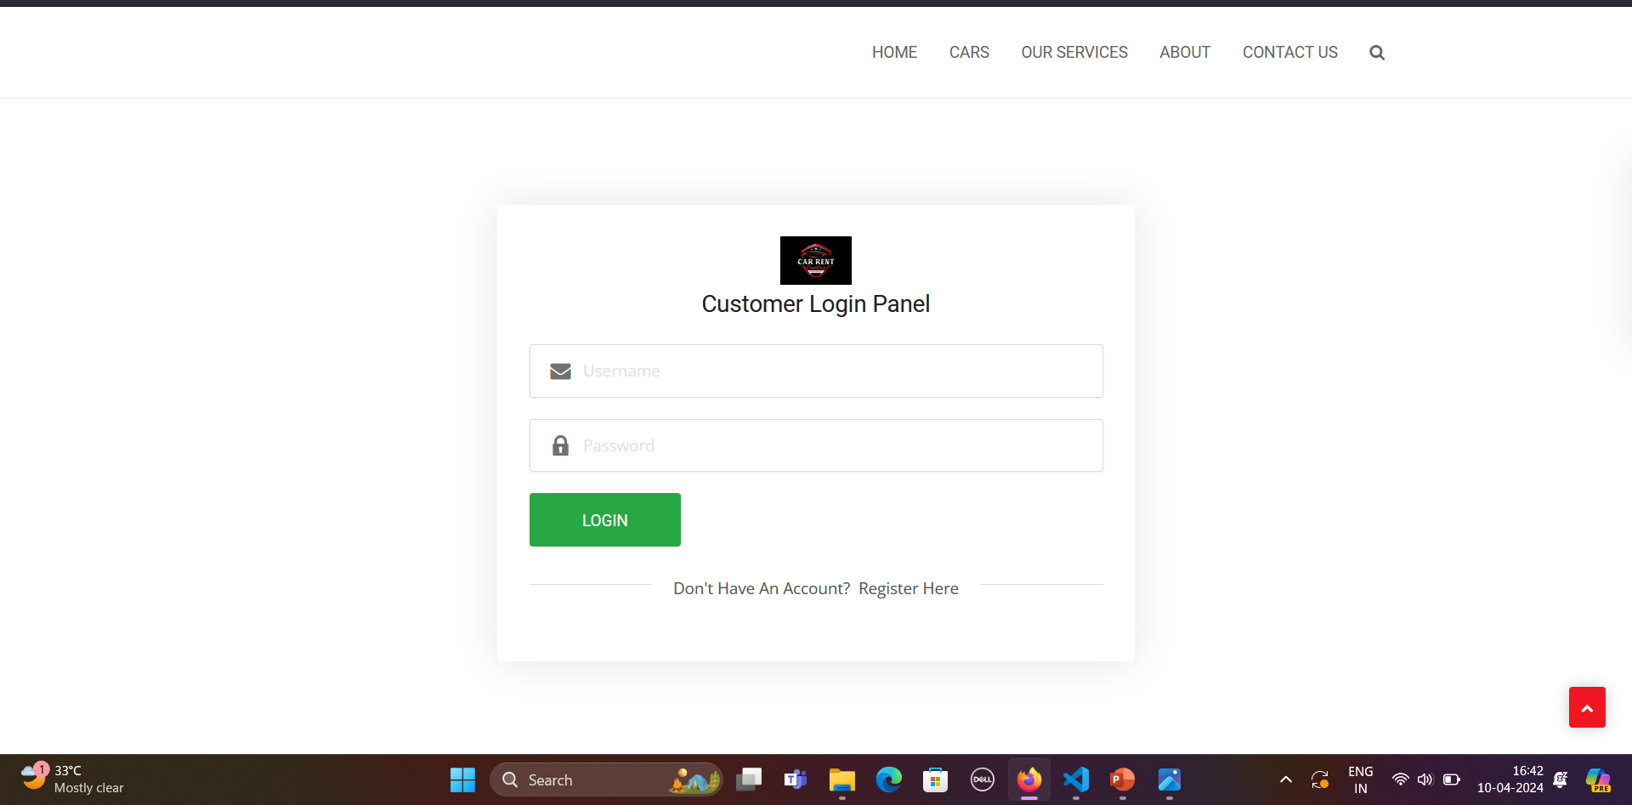
Login-page

Slide 15
Future Enhancements:
Integration with Ride-Sharing Services
Augmented Reality (AR) Vehicle Preview
Subscription-Based Rental Plans
Environmental Impact Calculator
Voice-Activated Booking Assistant

Slide 16
Conclusion
Our car rental site is poised for continued growth and innovation. With a focus on convenience, sustainability, and user satisfaction, we're committed to delivering an exceptional rental experience. Looking ahead, we'll continue to evolve, embracing new technologies and strategies to meet the needs of travelers worldwide.
Source :

Slide 17
Thank You!
Notes:
Thank You !!

